Slide 1
Biodiversity-A capstone Project on Codecademy
By:
Abhijay Paliwal

Slide 2
Provided Files Information
From database, species_info.csv :
Data file contains scientific name of species, common names and conservation status.
Data Deduction :
• A large percentage of species have no conservation status. We assume these are species that are not at risk of being endangered, and have had no intervention to date.
• There are a total of 5541 species: Mammals, Birds, Reptiles, Amphibian, Fish, Vascular Plants & Nonvascular Plants. Data Deduction
• Conservation status: Not specified, Species of Concern, Endangered, Threatened, In Recovery

Slide 3
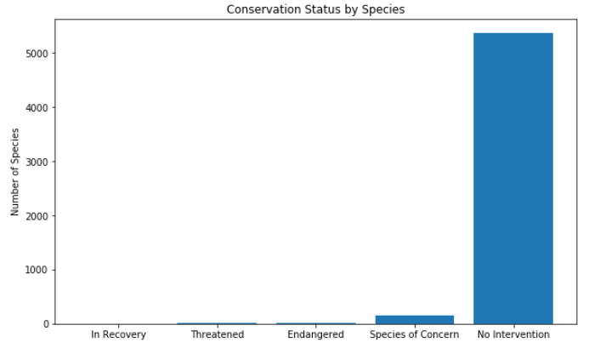
Conservation status by Species
After cleaning the data and grouping by conservation stats, we could see the data as the above bar chart

Slide 4
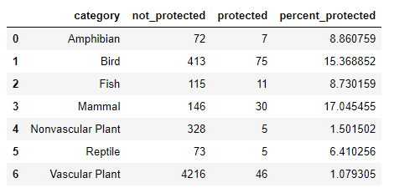
Statistical Analysis
We also made an table which consist of not protected and protected species, their category and their percentage
From the above table, Mammals and birds significantly stand out as being the most protected. Are mammals more likely to be endangered than birds?

Slide 5
Statistical Analysis
Also, A Chi Square test is done to answer this question. The results of a Chi Square test indicate ‘IF’ there is a significant difference between the two phylums. So a contingency table is made
From the chi test contingency table, It is observed that Mammals and birds indicated no significant differences between the phylums, in terms of if one was more likely to be endangered or not (p value = 0.69).
Also when test was ran on Reptiles and Mammals. Not the Result (p value = 0.038) indicates significant difference.

Slide 6
Final Analysis
From the above analysis, it is seen that Mammals are more at risk of being endangered than reptiles.
The following are some recommendations for the concern for endangered species:
1) More resources should be allocate to the protection of mammals than to reptiles
2) As due to mass urbanization and industrialization, their natural habitat should not be destroyed or harmed in any way
3) Also this model was an basic one, A large scale model should me made and studied with records of several past decades

Slide 7
Observation for different species Provided Information
From Database, observations.csv:
Data file contains scientific name of species, park name, and number of sightings.
Data Deduction:
1) Assumes 15% of sheep have foot and mouth disease
2) Park rangers want to be able to show if their disease reduction program is working or not. Our goal is to determine the sample size necessary for the results to show a detectable effect.

Slide 8
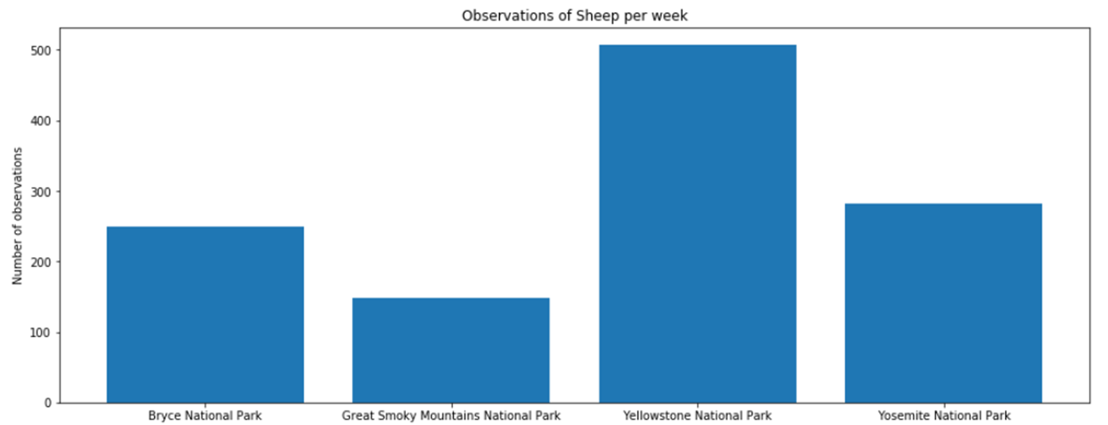
Observation on Sheep per week
Given the numbers of sheep sightings at each park, we can calculate the minimum number of weeks necessary to accumulate a sufficient sample size, for which to report the percentage of foot and mouth disease in the sheep population.

Slide 9
SAMPLE SIZE DETERMINATION
Minimum Detectable Effect: 33% Baseline: 15%
(based on Bryce National Park)
Using a standard sample size calculator we determined that 520 sheep observations would be necessary in order to determine the percentage with foot and mouth disease in the sheep population as a whole.
Based on the number of sightings per week, we can determine the duration for which the experiment should run.
1) Bryce National Park: 3 weeks (750 Sheep)
2) Yellowstone National Park: 2 weeks (1014 Sheep)

Slide 10
Thank You

